Slide 1
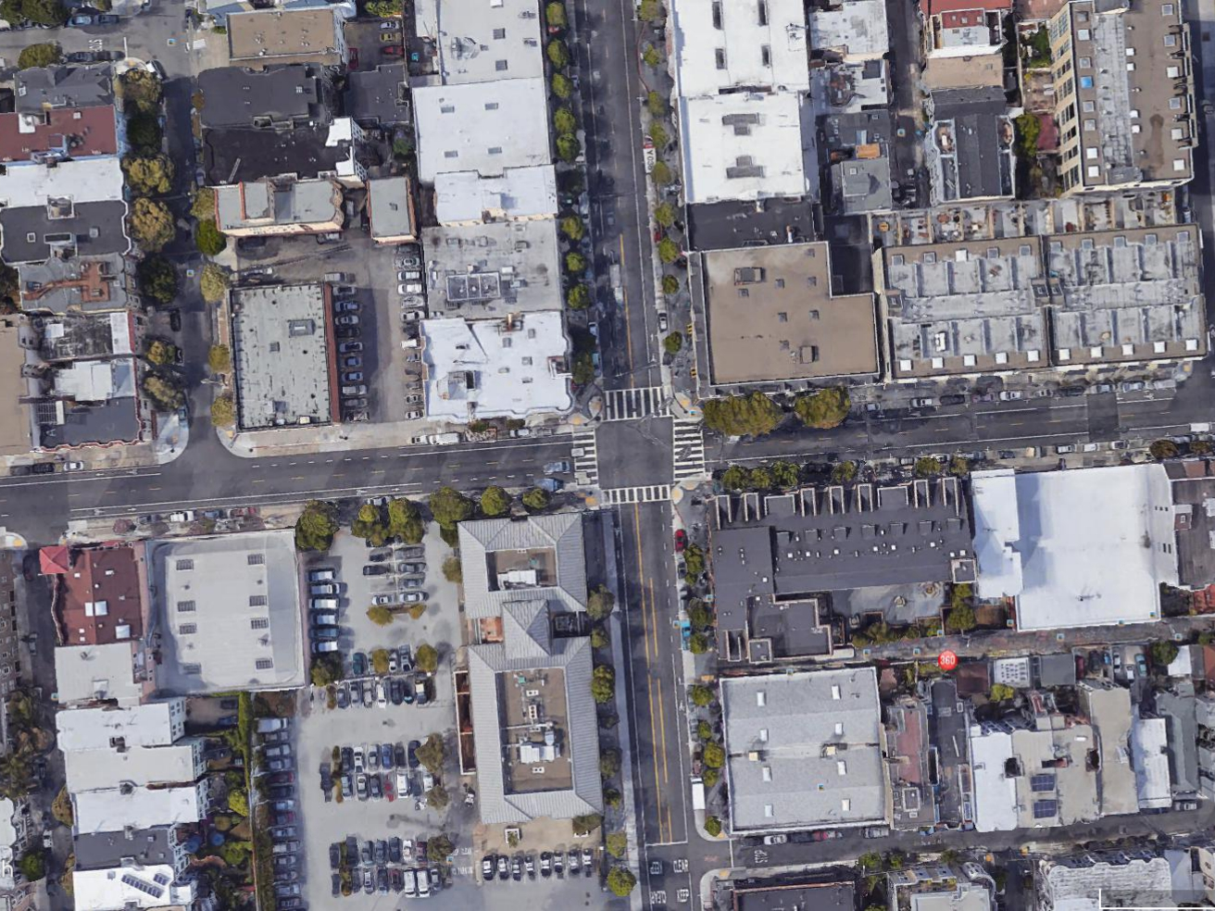
Valencia St
17th St

Slide 2
Valencia St
17th St

Slide 3
Valencia St
17th St

Slide 4
Valencia St
17th St

Slide 5
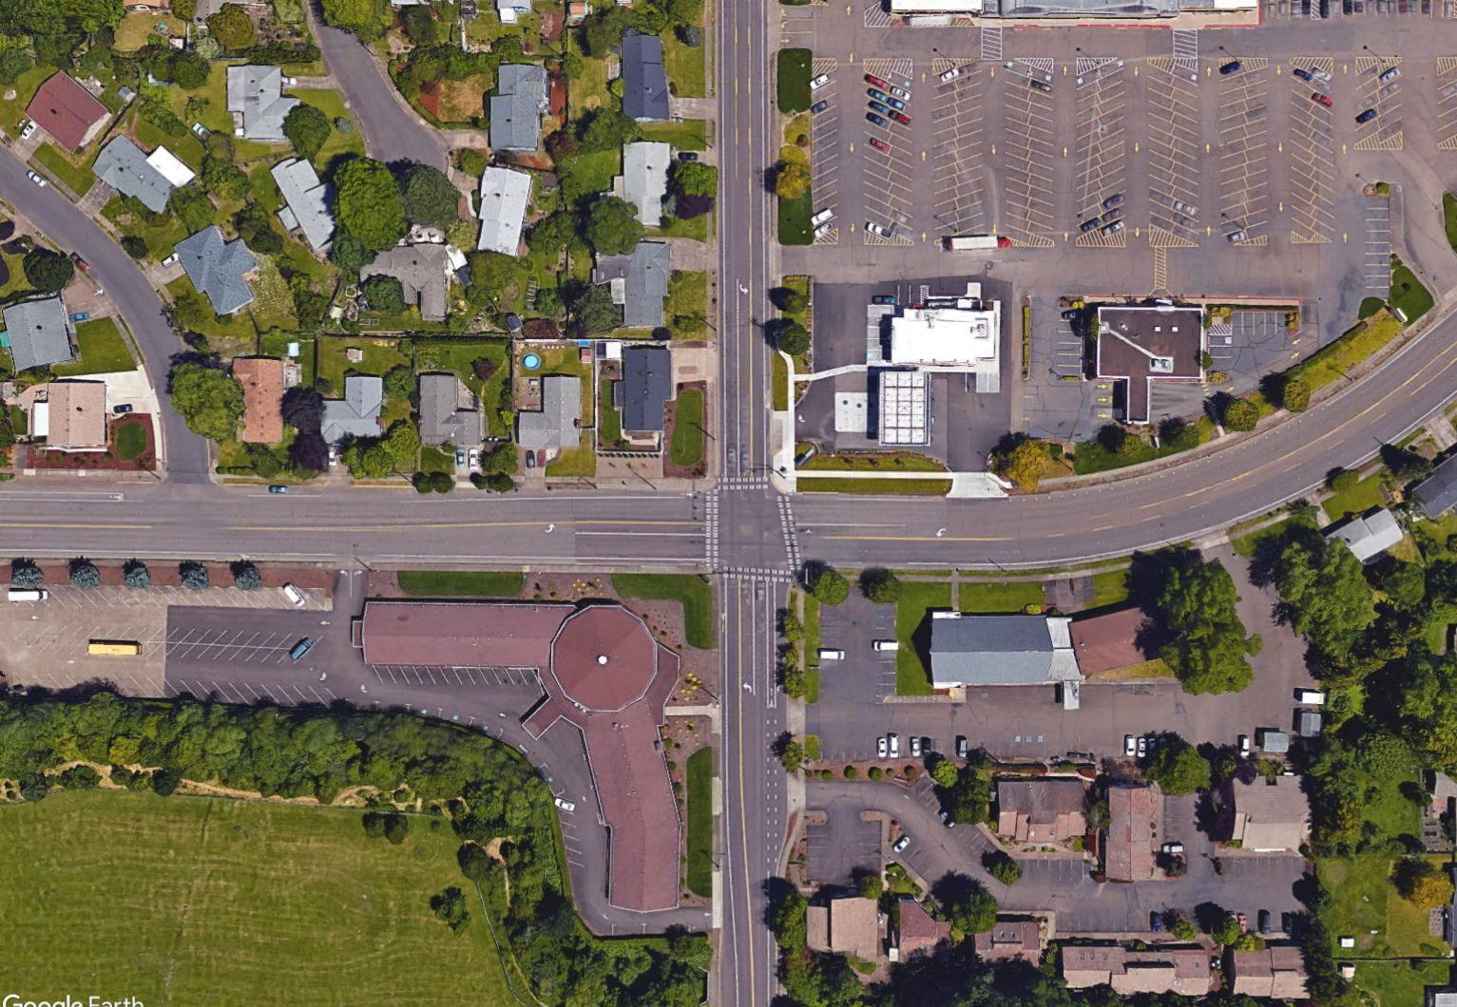
Kings Blvd
Circle Blvd
Circle Blvd

Slide 6
Kings Blvd
Circle Blvd
Circle Blvd

Slide 7
Kings Blvd
Circle Blvd
Circle Blvd

Slide 8
Kings Blvd
Circle Blvd
Circle Blvd

Slide 9
Kings Blvd
Circle Blvd
Circle Blvd

Slide 10
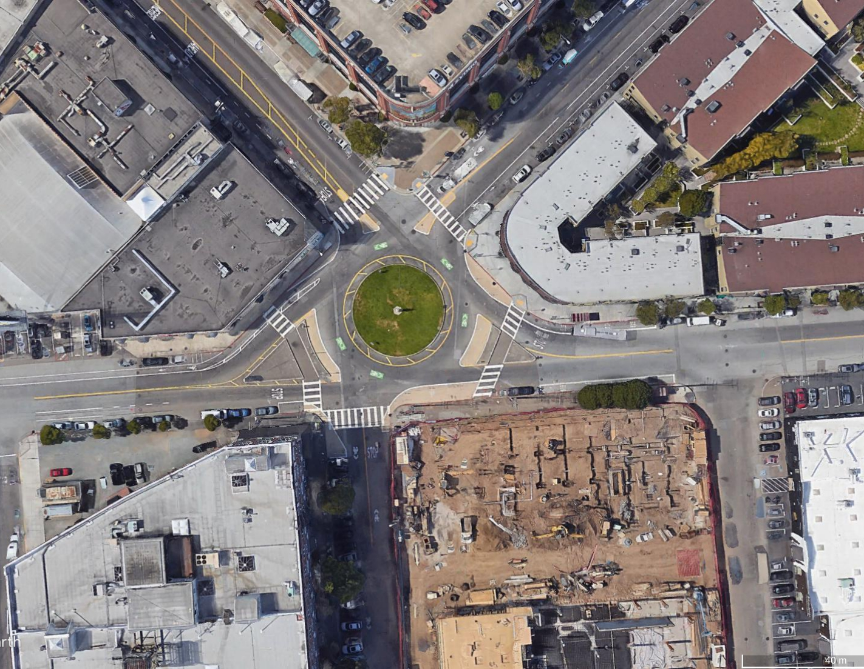

Slide 11
